Slide 1
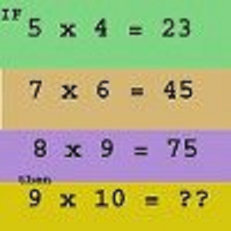

Slide 2
Warm-up March 25, 2013
Write each in slope-intercept form
3x + y = 5 2. 6x – 2y = 10 3. x –2y = -6
Solve for y:
4. √y = 3 5. 2x + √y = 8x 6. 6/y = 2/(x+1)

Slide 3
