Slide 1
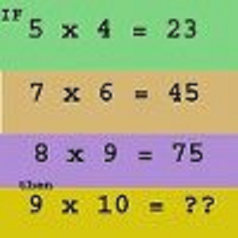

Slide 2
Warm-up March 25, 2013
Construct the box plot:
85, 95, 82, 89, 96, 83, 88, 82
Put the correlation coefficients in order from weakest to strongest
0.37, -0.41, 0.83, 0.27, -0.78

Slide 4
MCC9-12.S.ID.5 Summarize categorical data for two categories in two-way frequency tables. Interpret relative frequencies in the context of the data (including joint, marginal, and conditional relative frequencies). Recognize possible associations and trends in the data.
MCC9-12.S.ID.6 Represent data on two quantitative variables on a scatter plot, and describe how the variables are related.
MCC9-12.S.ID.9 Distinguish between correlation and causation.

