Slide 1
Warm Up
13, 13, 15, 9, 9, 12, 13, 15, 11
Find Q1, Median, and Q3
Find the IQR
Find the mean.
Find the mean absolute deviation.

Slide 2
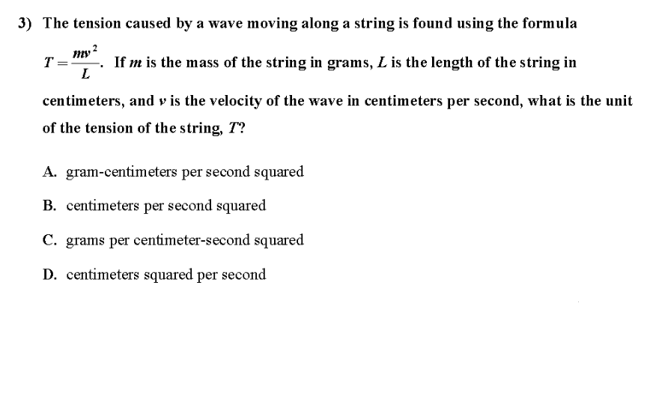
EOCT

Slide 3
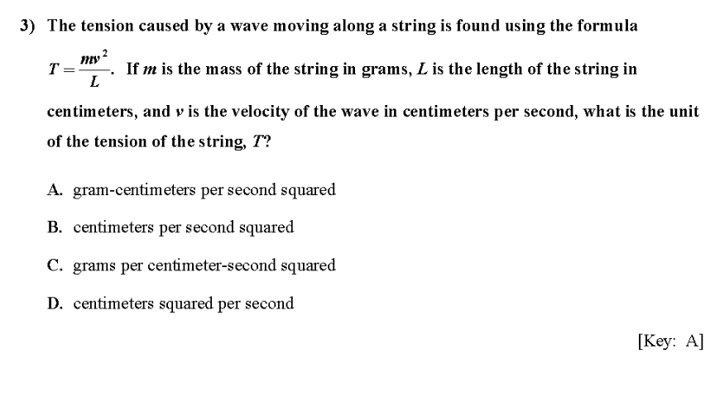
EOCT

Slide 4
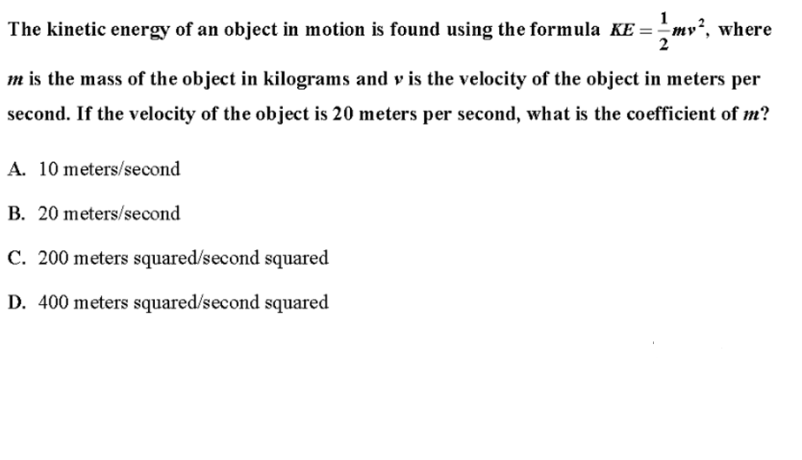
EOCT

Slide 5
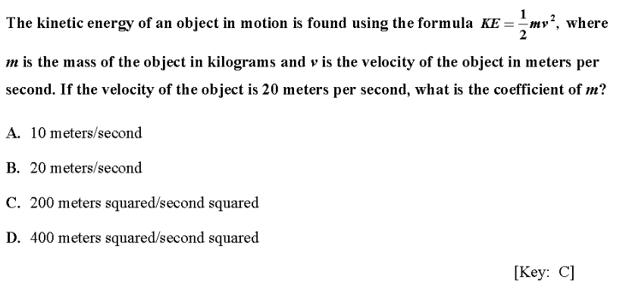
EOCT

Slide 6
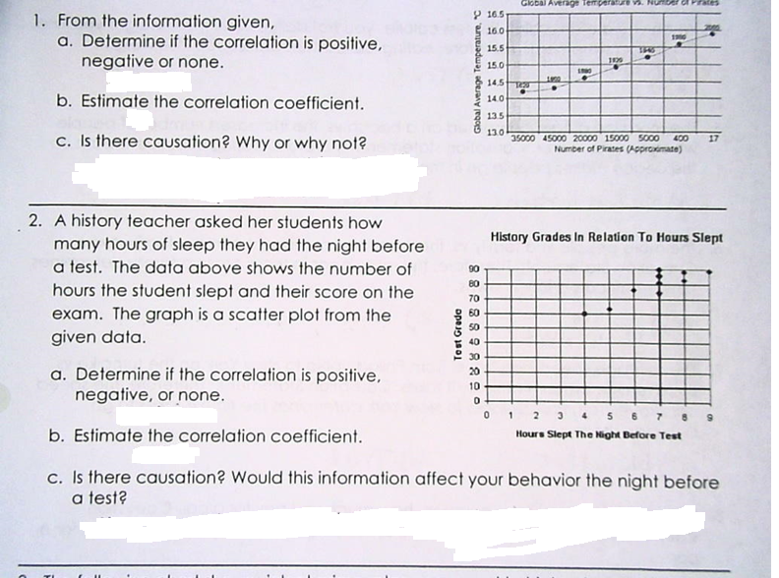
Review

Slide 7
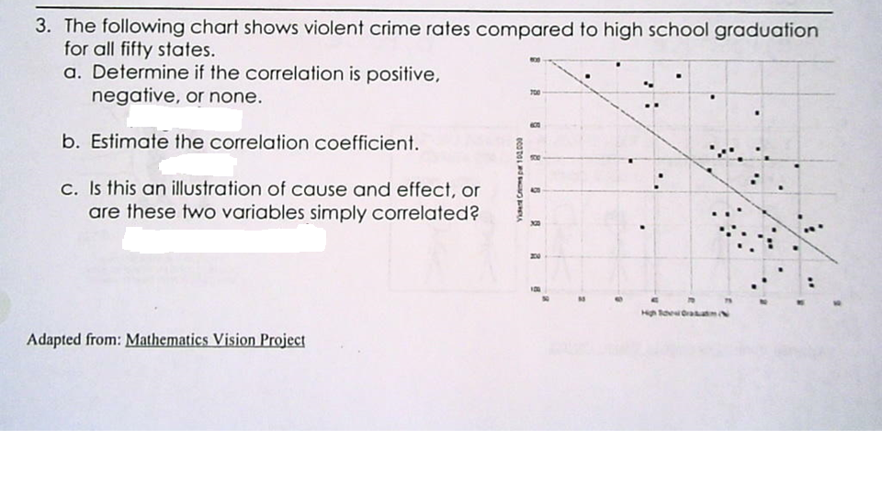
Review

Slide 8
Line of Best Fit
Linear Regression

Slide 9
Creating a Line of Best Fit WRITE THESE DOWN!
Plot all the data points (Make sure to label x and y-axes)
Use the edge of a paper to find the “line of best fit” (You are trying to split the data down the middle – try to go through some points but also have an even amount of points on each side)
Find the equation of the line
You will have to pick two points to find the slope
then you will have to solve for b by substituting into y = mx + b – use the slope you just found and one of your points for (x,y)

Slide 10
Example 1:
The environment club is interested in the relationship between the number of canned beverages sold in the cafeteria and the number of cans that are recycled. The data they collected are listed in this chart.
# of Cans Sold | 18 | 15 | 19 | 8 | 10 | 13 | 9 | 14
# of Cans Recycled | 8 | 6 | 10 | 6 | 3 | 7 | 5 | 4
Follow the three steps to find the line of best fit by hand and write it’s equation.

Slide 11
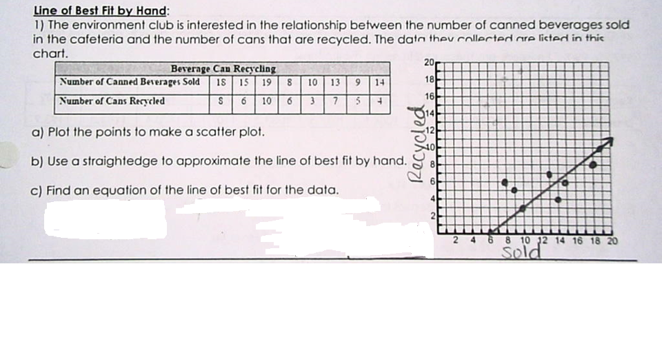
Example 1:

Slide 12
Example 1:

Slide 13
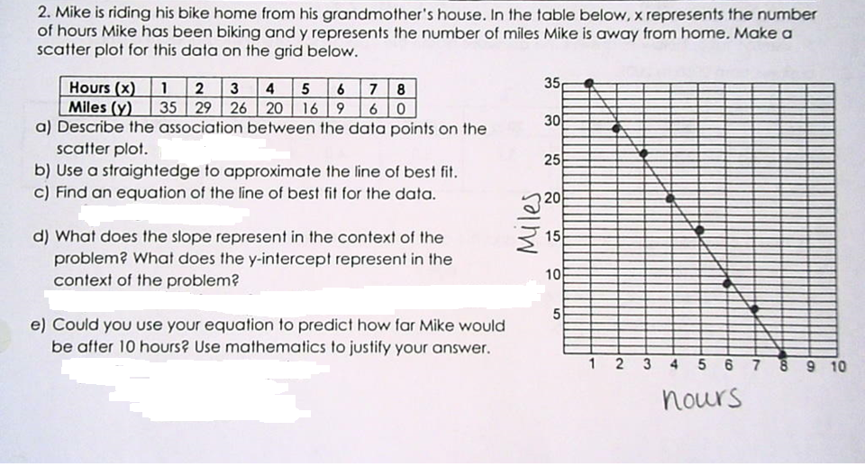
Example 2:
Try it own your own!

Slide 14
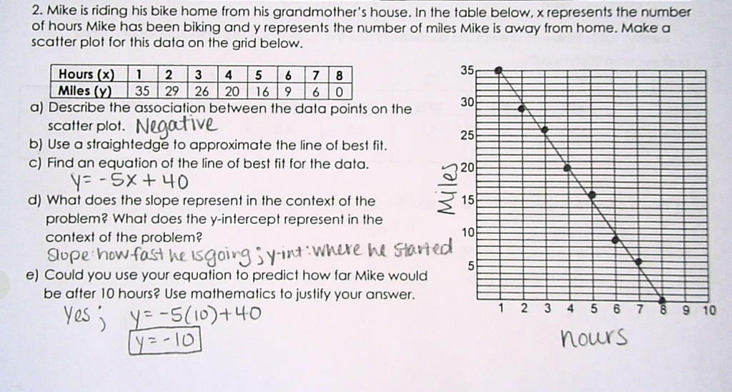
Example 2:
Try it own your own!

Slide 15
Line of Best Fit
Linear Regression by Calculator
See Handout for directions!

Slide 16
Entering Data : TI 36X - Pro
DATA (type in data)
2nd DATA
2 VAR L1 L2 Frequency of 1 Calc
a =
b =
r =
The equation of the line is y = ax + b.
Correlation Coefficient is r.
To predict use a(predict #) + b. Estimated method
You can use the x variable button to find a and b

Slide 17
Example 3:
Biggest thing you guys need to understand is “zeroing out” the x-values. Putting in the years can be too big for the calculator so we make the first year 0 and rename the other years in relation to “year 0”.
So,
Becomes:
Now follow the calculator directions to find the line of best fit.
Year | 2002 | 2003 | 2004 | 2005
Population | 16.4 | 17.0 | 17.4 | 17.8
Year | 0 | 1 | 2 | 3
Pouplation | 16.4 | 17.0 | 17.4 | 17.8

Slide 18
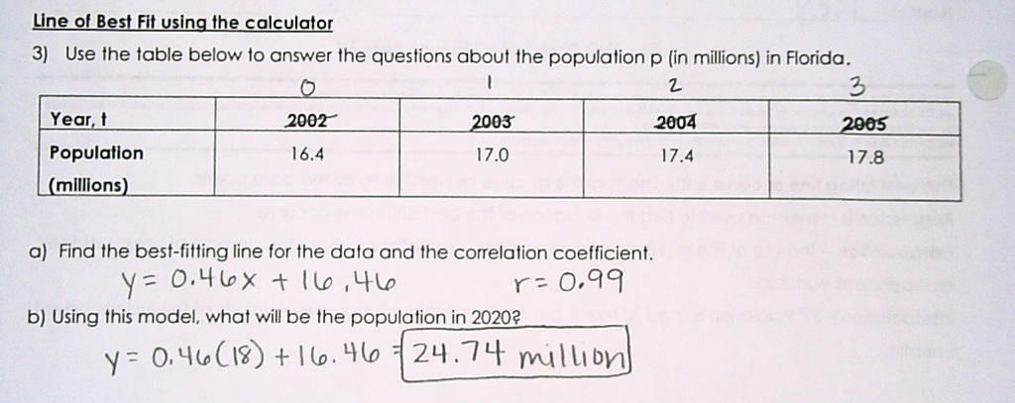
Example 3 Answer:

Slide 19
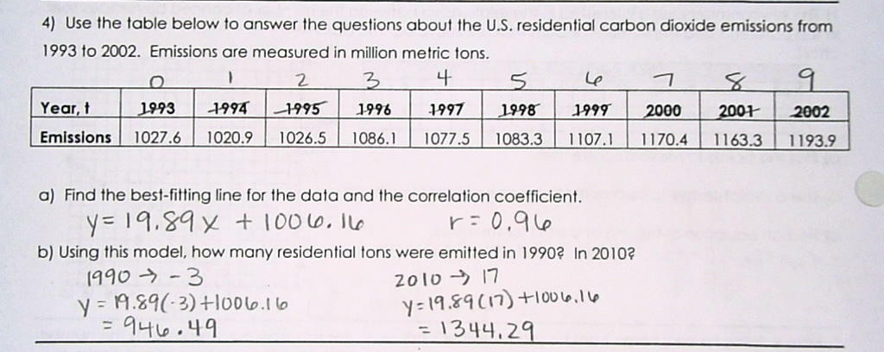
Example 4 Answer: TRY IT!

Slide 20
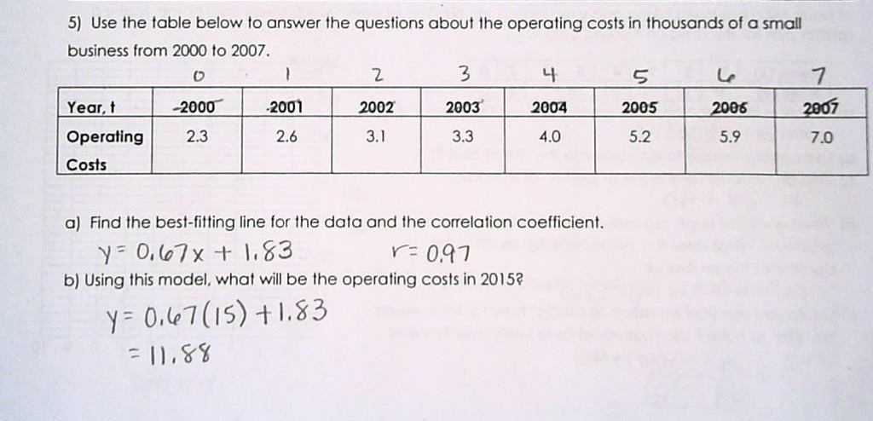
Example 5 Answer: TRY IT!

Slide 21
Homework
Linear Regression Task

