Slide 1
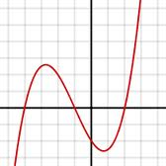
Warm up
Which one is even, odd, or neither?
f(x) = x
f(x) = 2x² + 4
odd
even
neither

Slide 2
Skills Check

Slide 3
Math is brought to you by the number …
April 2, 2013
Day 58 of 90
90-58 =

Slide 5
Interactive Notebook
P 43 MCC912.A.REI.12
Graph the solutions to a linear inequality in two variables as a half plane (excluding the boundary in the case of a strict inequality),

Slide 6
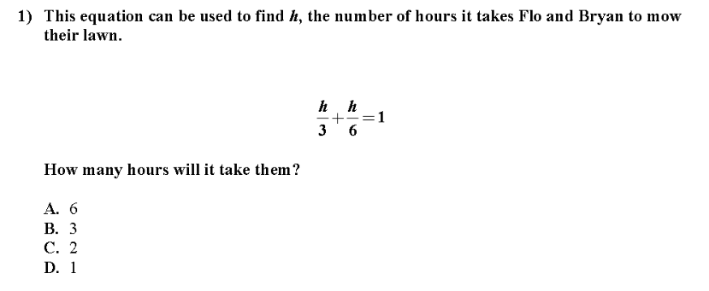
EOCT

Slide 7
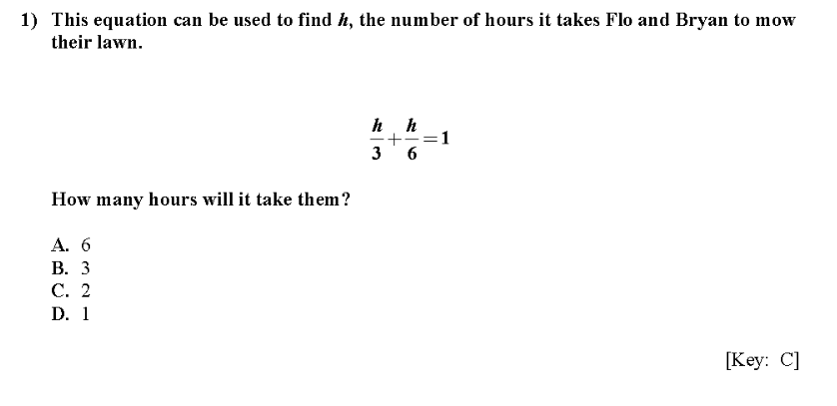
EOCT

Slide 8
EOCT

Slide 9
EOCT

Slide 10
EOCT

Slide 11
EOCT

Slide 12
Translations

Slide 13
Translate the image by (x – 8, y + 2)

Slide 14
Translate the image by (2x + 2, y – 3)

Slide 15
Find the pre-image (x + 12, y – 17)

